Slide 1
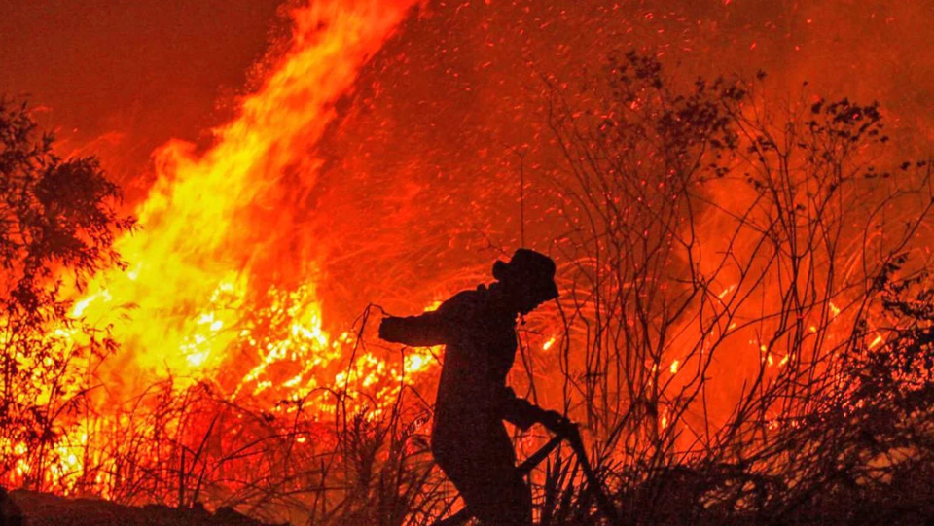
PREDICTING HOTSPOT INTENSITIES
Say Yueyang, Symus | He Zeqing | Kwek Yan Qing

Slide 2
TABLE OF CONTENTS
1
INTRODUCTION
2
MOTIVATION
3
PROPOSED SOLUTION
4
ANALYSIS
5
CONCLUSION

Slide 3
INTRODUCTION
Notes:
Haze is one major form of air pollution that Singaporeans face annually. The presence of haze is attributed to the forest fires in Sumatra, Indonesia. Due to the increase in demand of commercial crops, Indonesian farmers have resorted to shifting agriculture, which includes the large-scale slash-and-burn of forest land to produce fertile planting grounds. The resulting air pollution is then spread across the region by the climatic phenomenon El Nino, enveloping Singapore in a blanket of haze and affecting the overall health of Singaporeans. In 2020, Indonesia fires torched approximately 207,000 hectares of forests from January to September. While the area is smaller compared to previous years, the burning resulted in a US$5.2 billion cost towards the Indonesian economy, and the occurrence of toxic smog over the city.

Slide 4
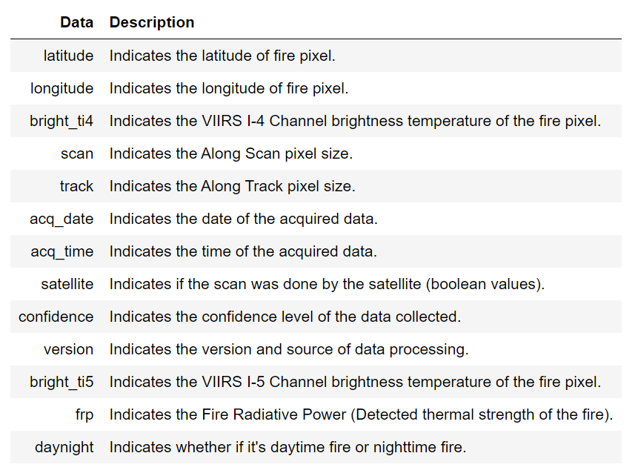
MOTIVATION
Notes:
The objective of our study is to predict the possible intensity of future hotspots in South East Asia, including Indonesia. Hopefully, this study will be able to support further research in estimating the possibility and severity of the occurrences of haze in Singapore.
Our study will be conducted with the relevant data on forest fires in South East Asia. Our dataset is obtained from the National Aeronautics and Space Administration (NASA)'s Fire Information for Resource Management System (FIRMS). It contains both geographical and technical data extracted from the Visible Infrared Imaging Radiometer Suite (VIIRS) sensor aboard their NOAA-20 weather satellite.

Slide 5
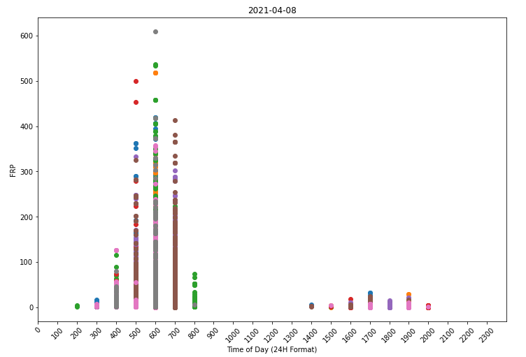
PROPOSED SOLUTION
Exploratory Data Analysis
Data Pre-Processing

Slide 6
PROPOSED SOLUTION

Slide 7
PROPOSED SOLUTION

Slide 8
ANALYSIS
OBSERVATIONS
LIMITATIONS
RECOMMENDATIONS

Slide 9
ANALYSIS
OBSERVATIONS
LIMITATIONS
RECOMMENDATIONS

Slide 10
ANALYSIS
OBSERVATIONS
LIMITATIONS
RECOMMENDATIONS

Slide 11
CONCLUSION

Slide 12
CONCLUSION

Slide 13

THANKS!
Do you have any questions? youremail@freepik.com +91 620 421 838
yourcompany.com
Please keep this slide for attribution

Slide 14





Storyset
Create your Story with our illustrated concepts. Choose the style you like the most, edit its colors, pick the background and layers you want to show and bring them to life with the animator panel! It will boost your presentation. Check out How it Works.
Pana
Amico
Bro
Rafiki
Cuate

Slide 15
Use our editable graphic resources...
You can easily resize these resources without losing quality. To change the color, just ungroup the resource and click on the object you want to change. Then, click on the paint bucket and select the color you want. Group the resource again when you’re done. You can also look for more infographics on Slidesgo.

Slide 18
JANUARY
FEBRUARY
MARCH
APRIL
MAY
JUNE
PHASE 1
Task 1
Task 2
PHASE 2
Task 1
Task 2
JANUARY
FEBRUARY
MARCH
APRIL
PHASE 1
Task 1
Task 2

Slide 21
...and our sets of editable icons
You can resize these icons without losing quality.
You can change the stroke and fill color; just select the icon and click on the paint bucket/pen.
In Google Slides, you can also use Flaticon’s extension, allowing you to customize and add even more icons.

Slide 22
Educational Icons
Medical Icons

Slide 23
Business Icons
Teamwork Icons

Slide 24
Help & Support Icons
Avatar Icons

Slide 25
Creative Process Icons
Performing Arts Icons

Slide 26
Nature Icons

Slide 27
SEO & Marketing Icons

Slide 28


